Slide 1

AI ADOPTION IN EUROPE
From Experiment to Operating Model: Navigating the acceleration of enterprise intelligence.
20%
EU ENTERPRISE ADOPTION (2025)

Slide 2

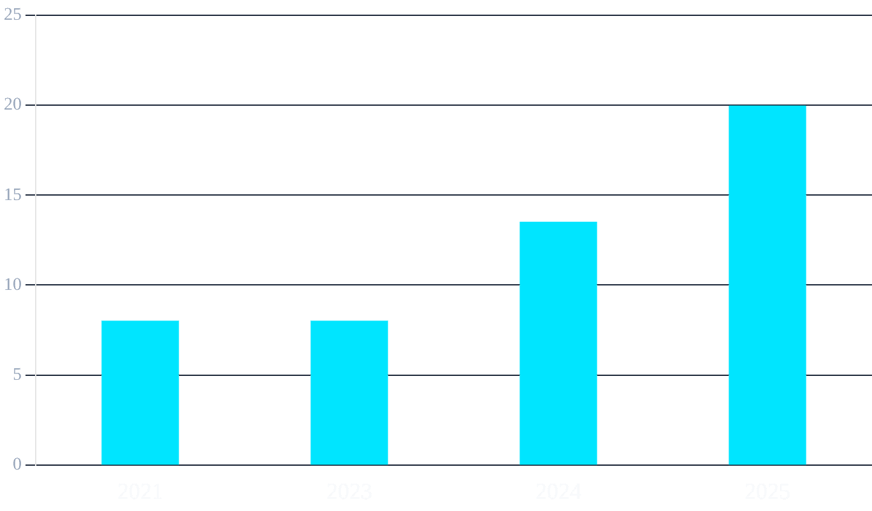
ADOPTION IS MOVING FROM NICHE TO NORM
THE ACCELERATION PHASE
Enterprise AI adoption in the EU has more than doubled in three years, jumping from 8% in 2023 to nearly 20% in 2025.
MAINSTREAM INTEGRATION
What was once experimental is now a core operational requirement. Text mining and natural language generation lead the current wave of deployment.
Source: Eurostat (isoc_eb_ai), 2025. Data refers to enterprises with 10+ employees.

Slide 3

THE MAP IS UNEVEN
COUNTRY
ADOPTION RATE (2025)
Denmark
42.0%
The Nordic Lead
Finland
37.8%
Denmark and Finland have established a significant lead, with over 1 in 3 enterprises utilizing AI technologies.
Sweden
35.0%
The Convergence Gap
Bulgaria
8.6%
A massive 37-percentage-point spread exists between the highest and lowest adoption rates in the EU, highlighting a persistent digital divide.
Poland
8.4%
Romania
5.2%
Source: Eurostat (isoc_eb_ai), 2025. Data refers to enterprises with 10+ employees.

Slide 4
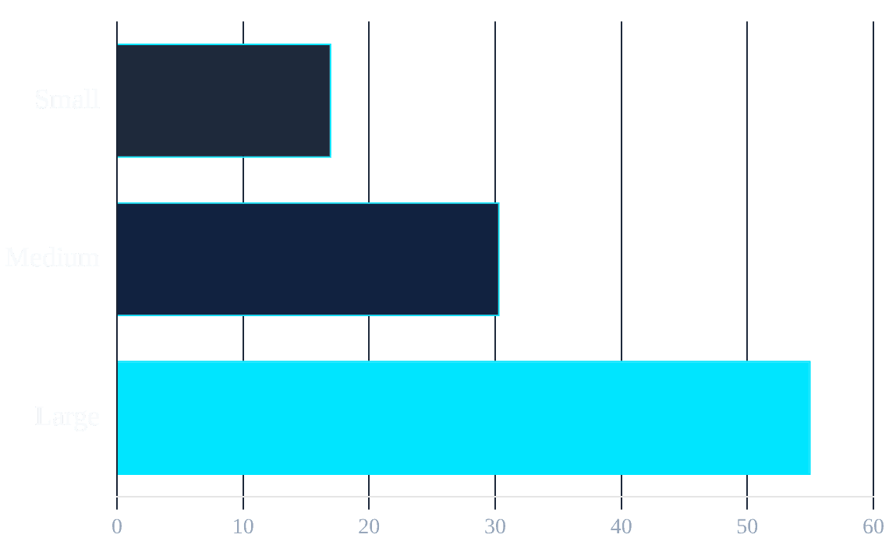
SCALE STILL DETERMINES WHO CAPTURES VALUE
55%
Large Enterprises
Over half of large firms have integrated AI into their operations.
17%
Small Enterprises
SMEs face higher barriers to entry, including cost and talent acquisition.
3.2x
The Multiplier
Large firms are 3.2 times more likely to use AI than small firms.
Source: Eurostat (isoc_eb_ai), 2025. Large: 250+ employees; Small: 10-49 employees.

Slide 5
EUROPE’S NEXT ADVANTAGE IS RESPONSIBLE SCALE
01
02
03
OPERATIONALIZE THE AI ACT
BRIDGE THE SME TALENT GAP
FOCUS ON HIGH-VALUE WORKFLOWS
Compliance is not just a hurdle; it is a foundation for trust. Firms that lead in "Trustworthy AI" will capture the high-value regulated sectors.
The 3.2x adoption gap is a risk to European competitiveness. Policy and industry must focus on democratizing access to AI infrastructure and talent.
The shift from experiment to operating model requires moving beyond simple text mining to complex, autonomous decision-making systems.
2026
THE YEAR OF RESPONSIBLE SCALE
Analysis based on European Commission & Eurostat 2025 reports.

